Slide 1
PROGRAMMING PROJECT
CREATED BY:
MUHAMMAD HUNaiN
Muhammad ShahrukH Faizy
MUHAMMAD GHILMAN KHAN

Slide 2
What is scope planning in project management?
Scope Planning - It's a statement encompassing the project justification, the deliverables, and the objectives.
The primary purpose of project scope management is to ensure that all the required work and only the required work is performed to complete the project successfully. This is accomplished by defining and controlling what is included in the project and what is not.

Slide 3

MAIN PAGE:

Slide 4

USER LOGIN: user name: csstudent pass word: - - - -

Slide 5

Main Menu:

Slide 6
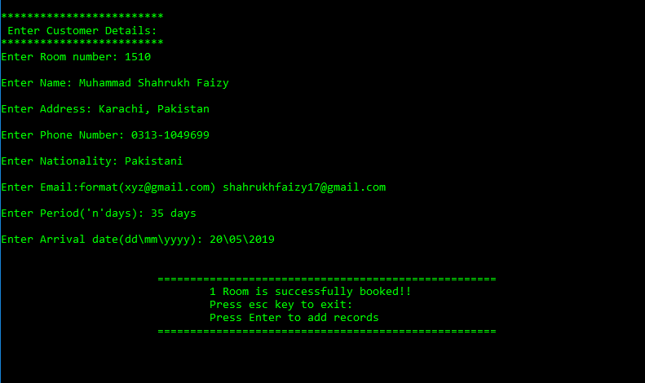
CHECK IN & check Out : press 1

Slide 7

Records: Press 2

Slide 8
Search Record: sub category of record [press 1]

Slide 9
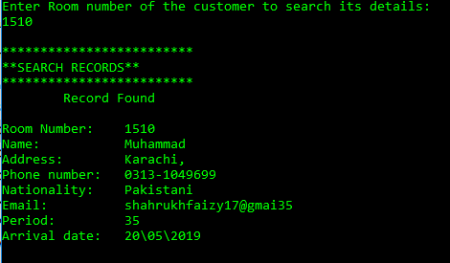
Edit records sub category of records [press 2]

Slide 10
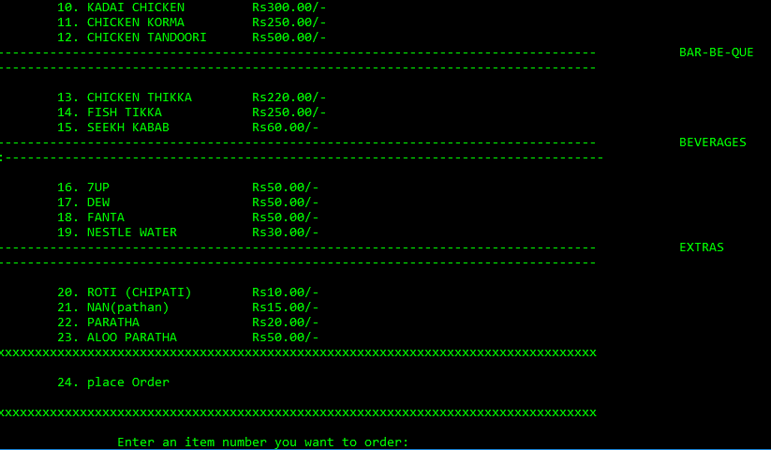
FOOD MENU : press 3

Slide 11
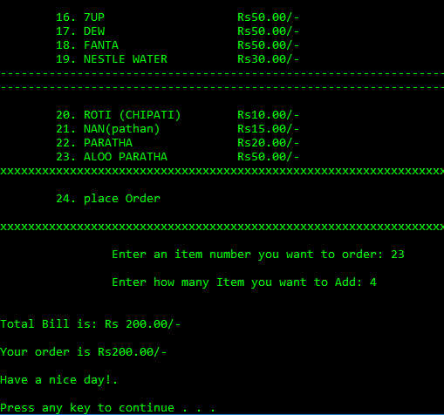
BILLING:

Slide 12
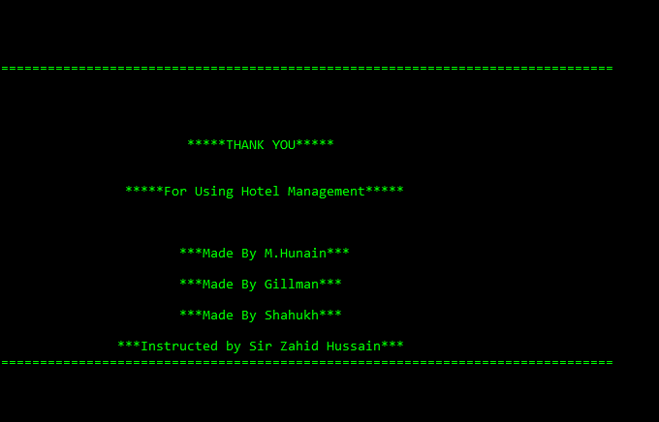
EXIT: press 5

Slide 13

THANK YOU!!

